Slide 1

Business Health Predictor
GROUP 09 | 04 AUGUST 2023

Slide 2

01 BUSINESS PROBLEM
There is a lack of comprehensive and reliable tools for individual investors to assess a company's financial stability and potential for sustainable growth.
When relying on traditional financial metrics and analysis, many investors are faced with challenges in identifying healthy companies to invest in.
This is because these metrics do not fully capture the entire picture of a company's long-term viability.

Slide 3

02 SOLUTION
OBJECTIVE
METHOD
SUCCESS CRITERIA

Slide 4
02 BUSINESS SOLUTION - OUR MODEL
02 SOLUTION
Accuracy and Robustness- Handles many different metrics to calculate accurate predictions on a company's health.
Risk Mitigation- Reduces risks by making informed decisions based on a company's financial health, and warns investors if company has vulnerabilities overlooked by traditional analysis.
Investor Confidence- Helps investors understand company financials better, allowing them to invest with more peace of mind knowing there's stability.
Adaptability- Adapts to changing market conditions and incorporate new data, making it a valuable tool for investors in any economic environment. Dynamic.
Down the Road- Our Business Health score helps not only understand shorter term safety, but is a great predictor of long term well being.
OBJECTIVE
METHOD
SUCCESS CRITERIA

Slide 5

Business Health Rating
Model target
Other heading notes……….??
Investment Recommendation | Avoid | Trending Positive | High Investment Potential
Business Health Rating | Week | Good | Best
1
2
3
4
5
6
7
8
9
Notes……….
Notes……….
Notes……….
Notes:
Tags: table, proposal, approach, objectives

Slide 6










Title
Title
SOLVENCY
EBIT / TOTAL ASSETS
LIQUIDITY
NET SALES / TOTAL ASSETS
PROFITABILITY
WORKING CAPITAL / TOTAL ASSETS
Notes:
Tags: technology, callout, icons

Slide 7
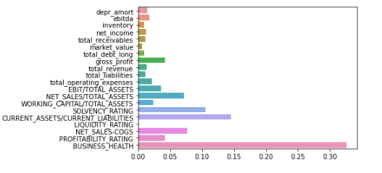
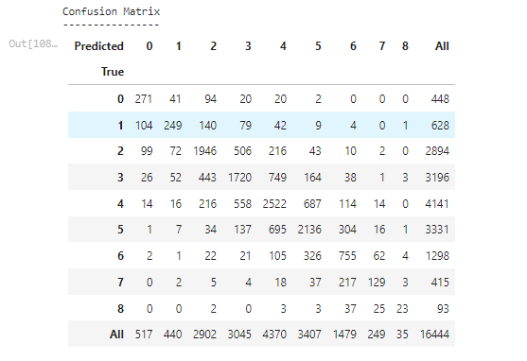
MODEL…

Slide 8

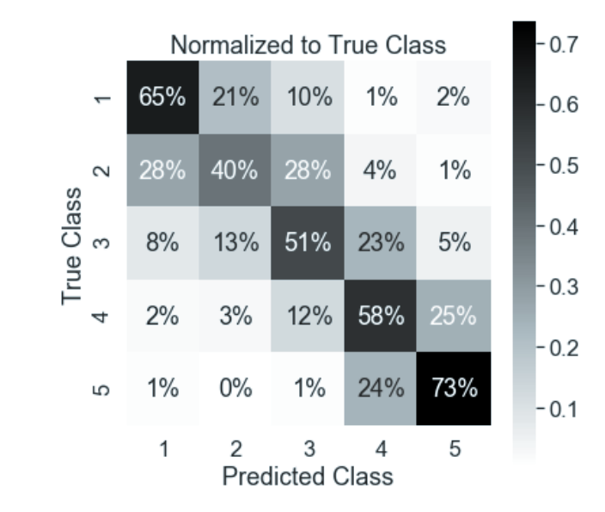
03 FINAL MODEL ANALYSIS
59.2%
87.3%
Overall Accuracy
+/- 1 Deviation

